Slide 1
Lab 1 Robertson's Multiplier
block diagrams
"X-ray view" of the hardware

Slide 2
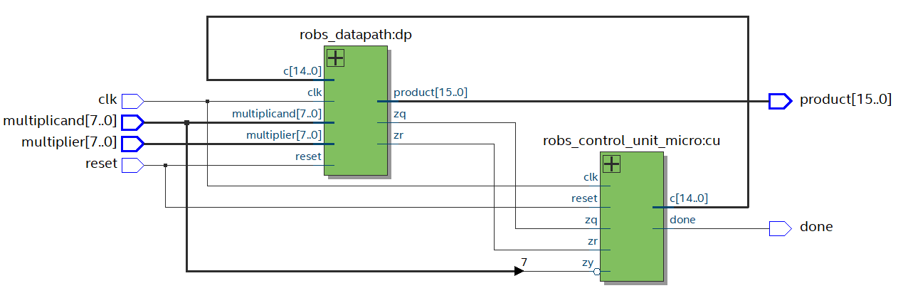
inside toprobertsons
Note datapath and control_unit
CU uses c[14:0] to tell dp what to do
Condition flags zq and zr feed back to the CU.

Slide 3
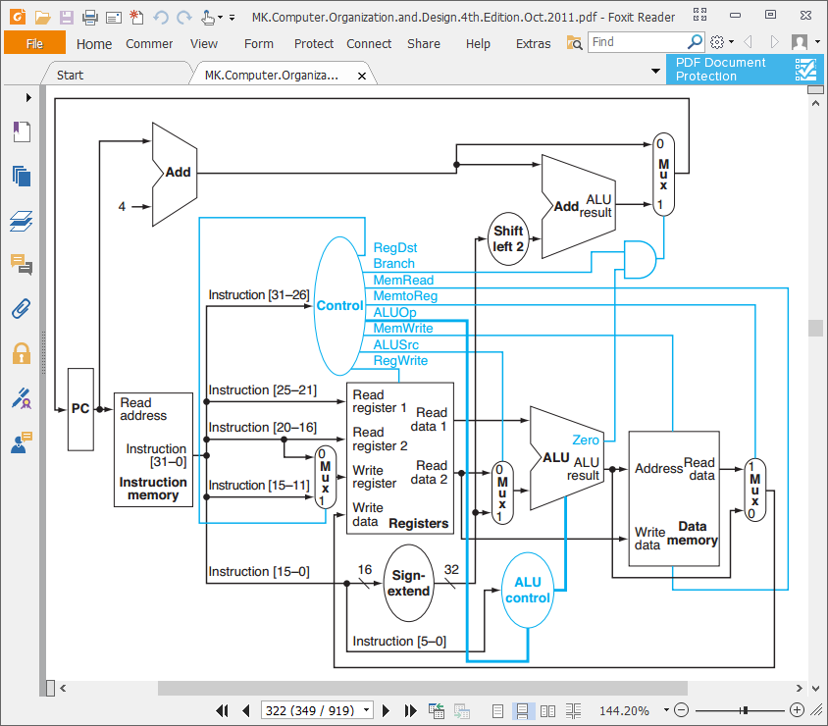
Simplified MIPS microprocessor
ProgramCounter + Instruction Memory + Control = control unit
Registers + ALU + Data memory = data path
Not identical, but similar in concept

Slide 4
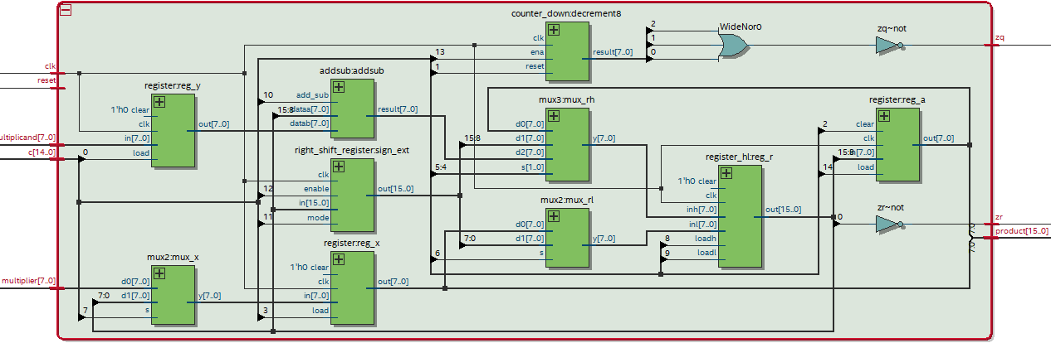
Inside the Data Path
Note addsub, registers, muxes, counter_down, zq and zr flag logic
Note fanout of control bus c[14:0] to various components

Slide 5
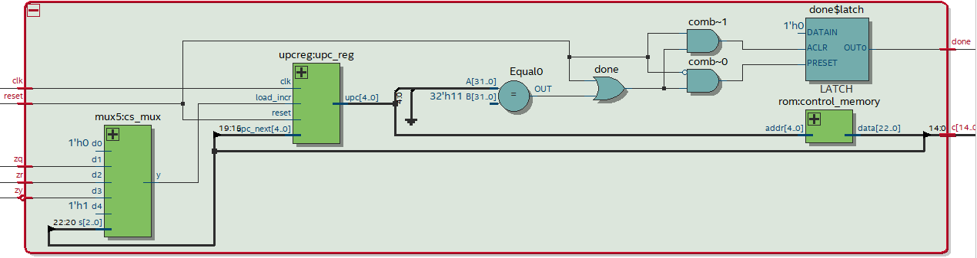
Inside the Control Unit
Note the program counter (upc_reg), the instruction memory (ROM), the 5-way mux, and the done flag logic (latch)

